Slide 1
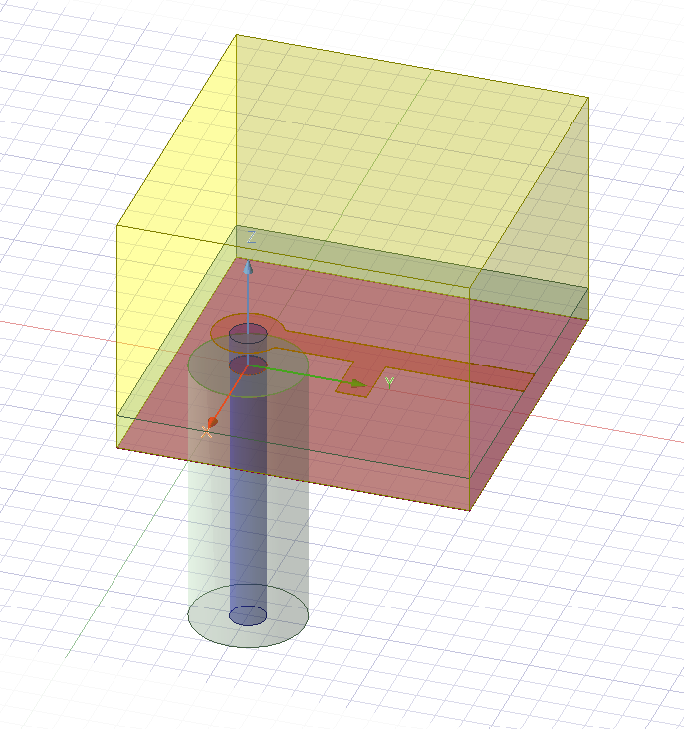
Design Project 6
By: Nittala Satya Surya Lakshmi Vasuki Siva Srinivas
#Id – 620094
#Email – sn620094@wne.edu

Slide 2
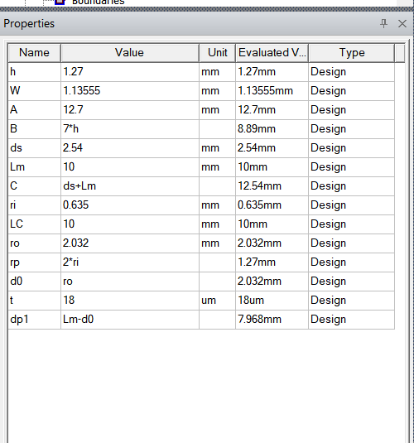
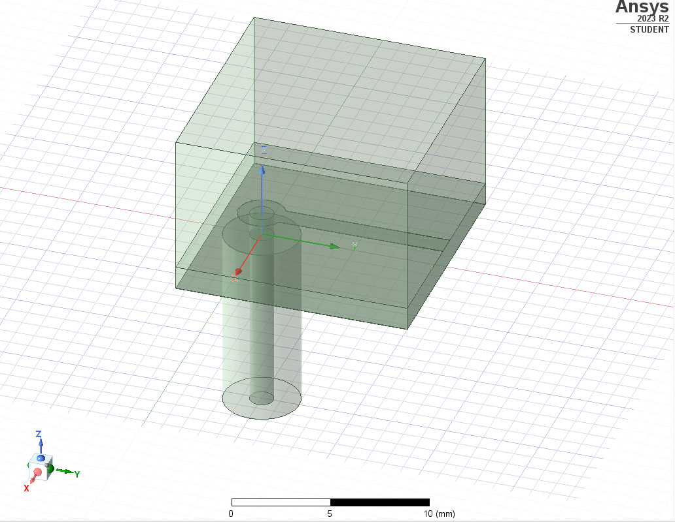
HFSS V0

Slide 3
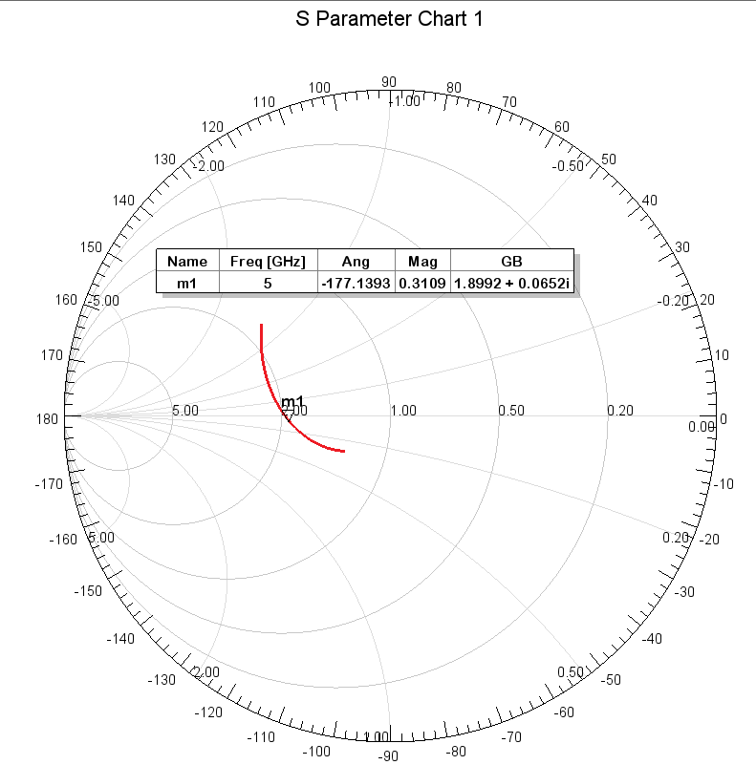
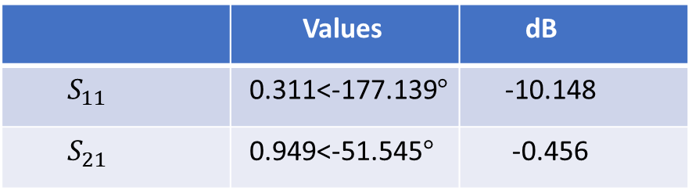
 | Values | dB
$S_{11}$ | 0.311<-177.139$°$ | -10.148
$S_{21}$ | 0.949<-51.545$°$ | -0.456

Slide 4
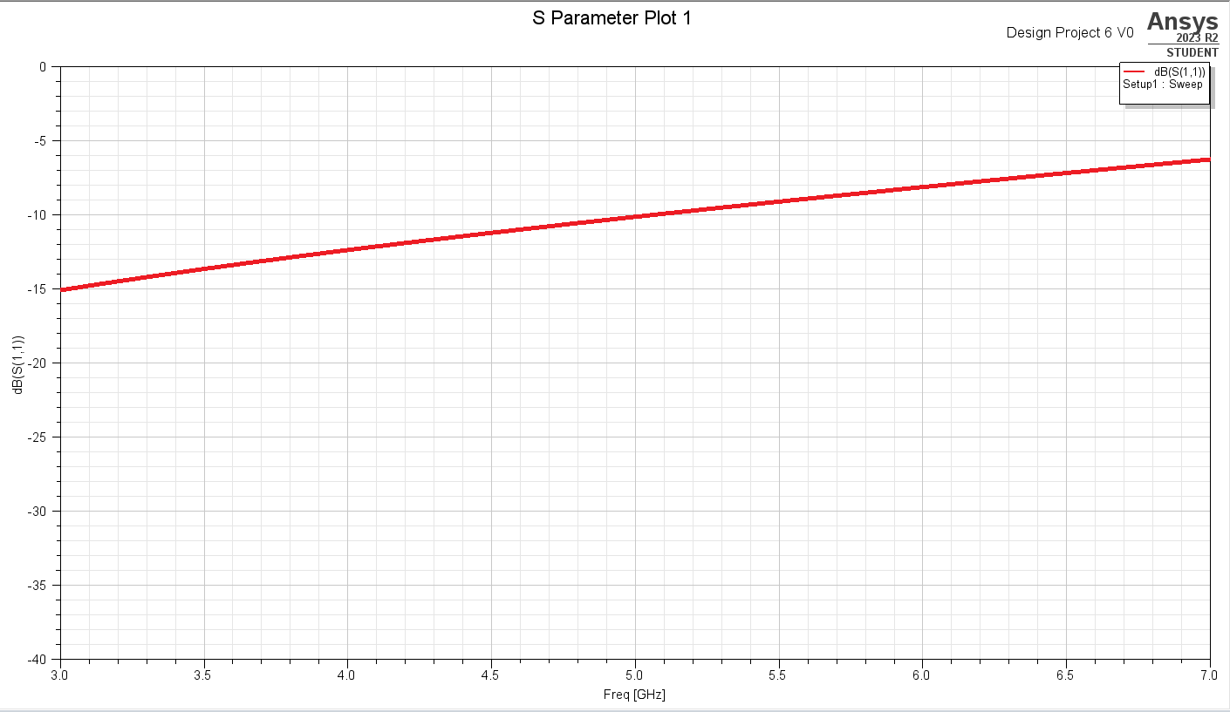

Slide 5
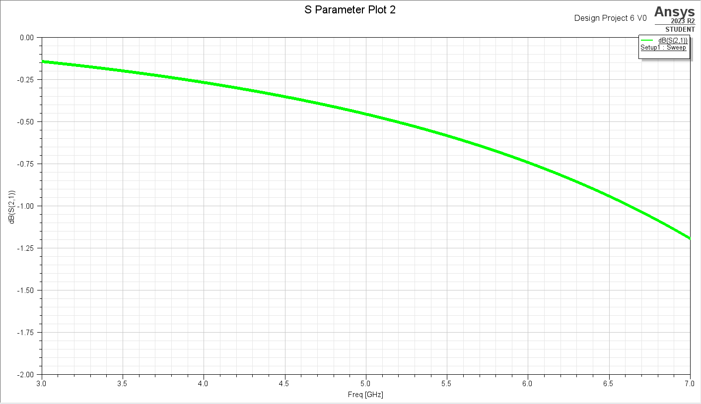

Slide 6
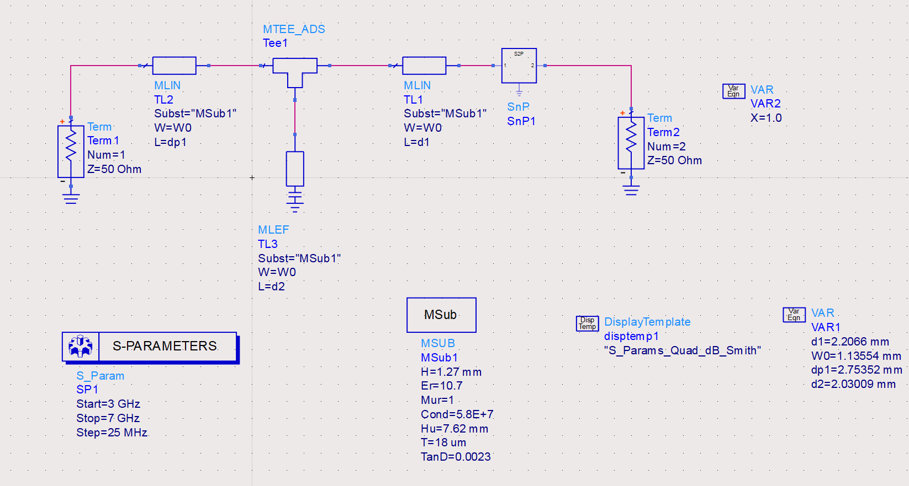
MStrip_V1

Slide 7
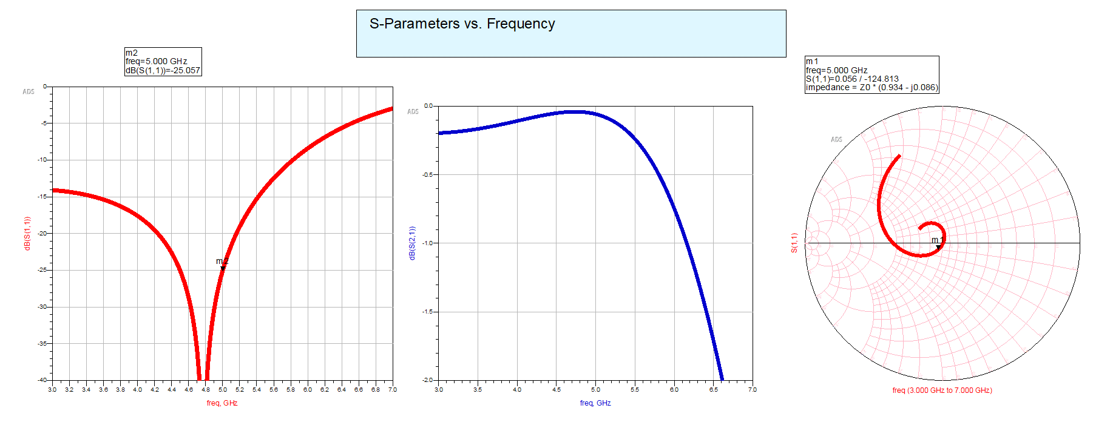
MStrip_V1

Slide 8
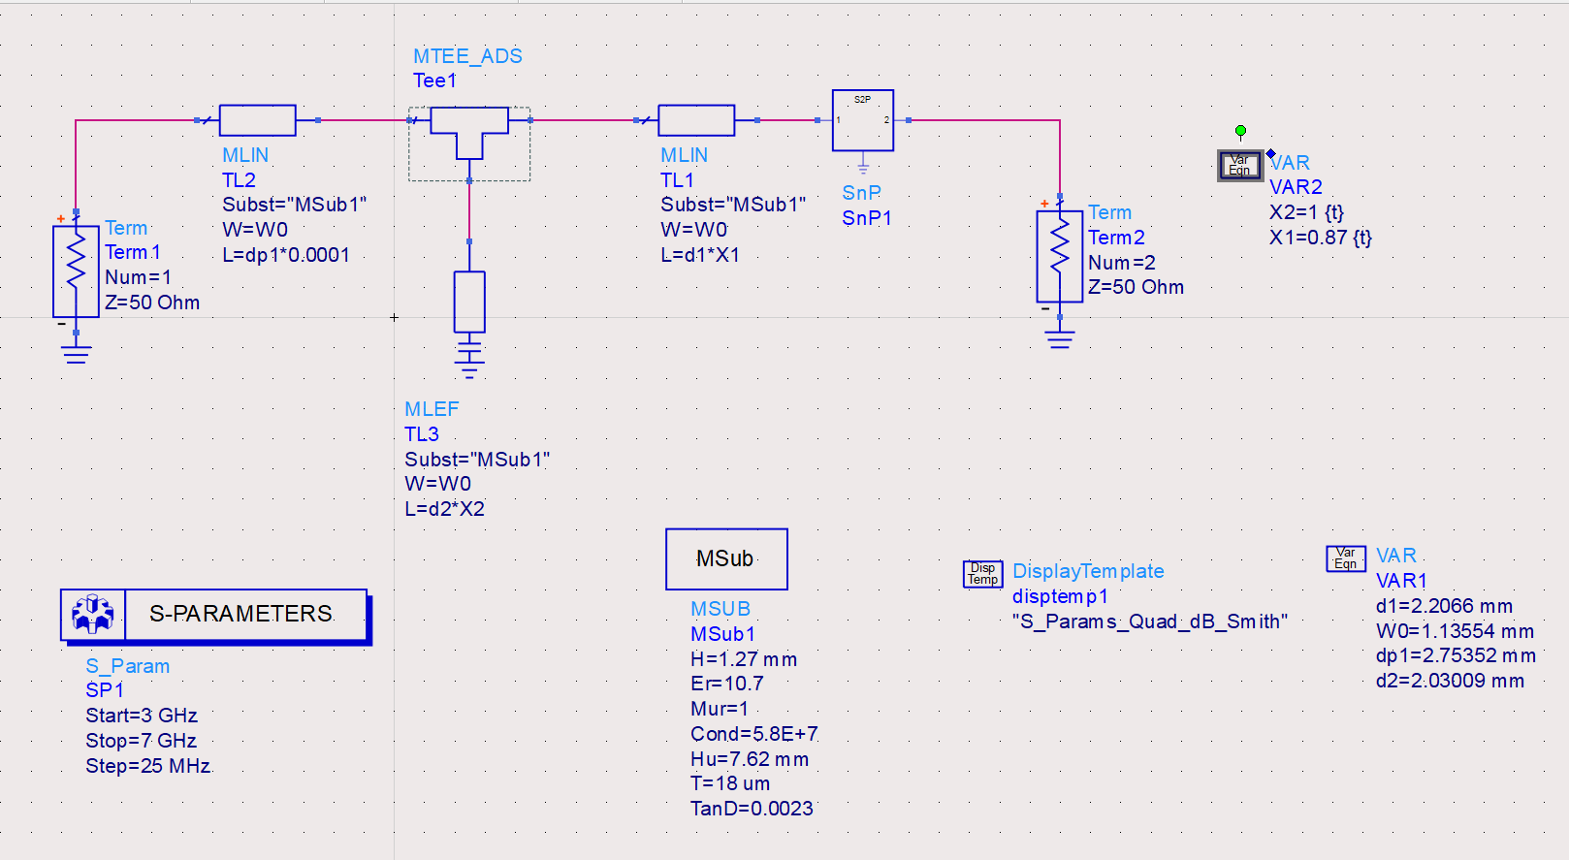
MStrip_V2

Slide 9
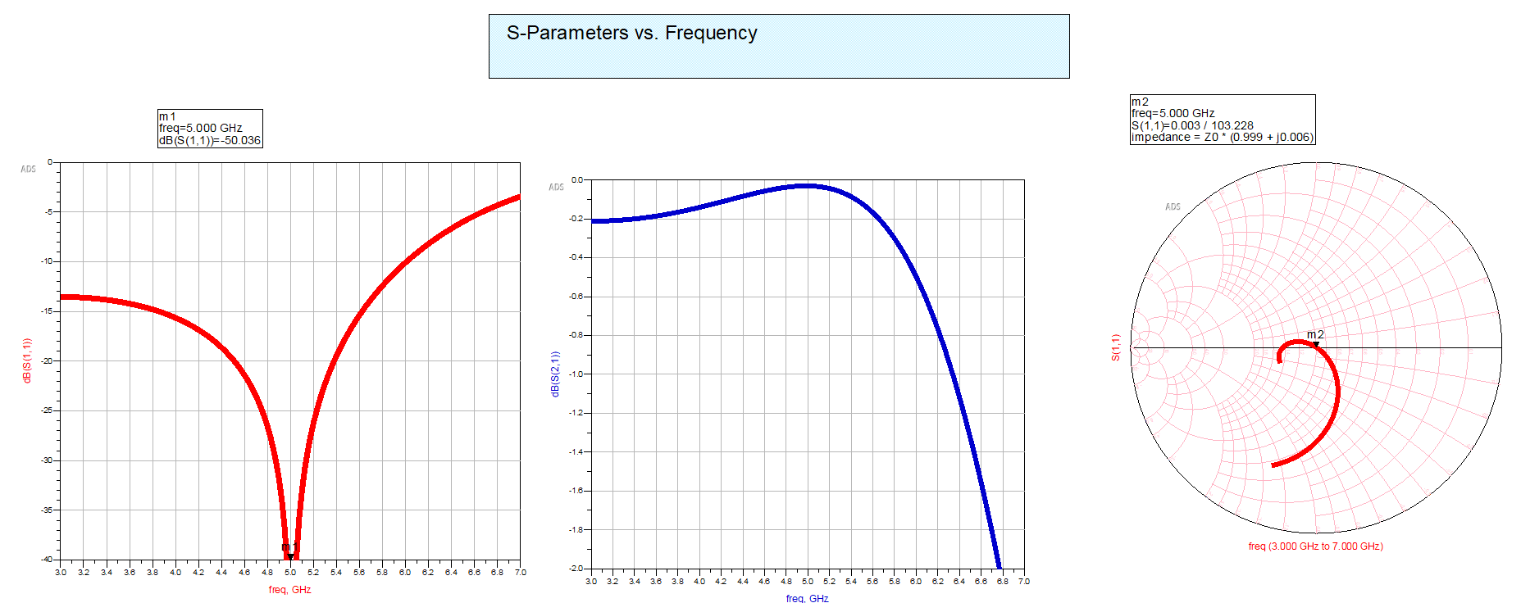
MStrip_V2

Slide 10
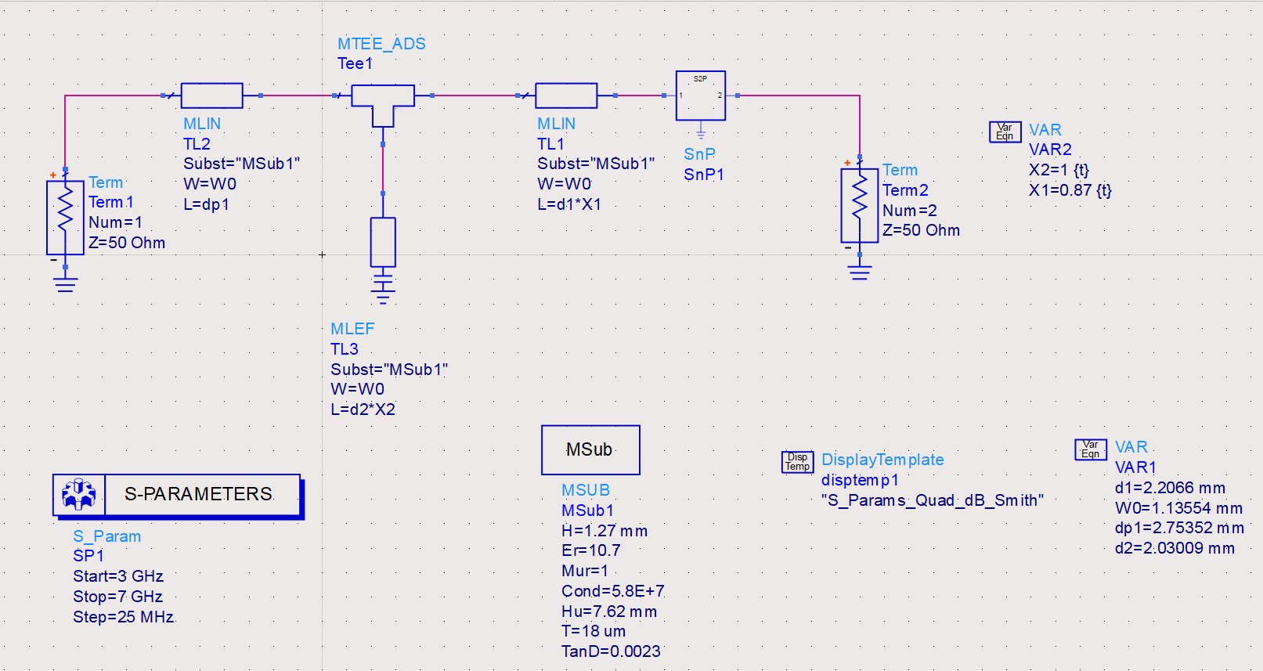
MStrip_V3

Slide 11
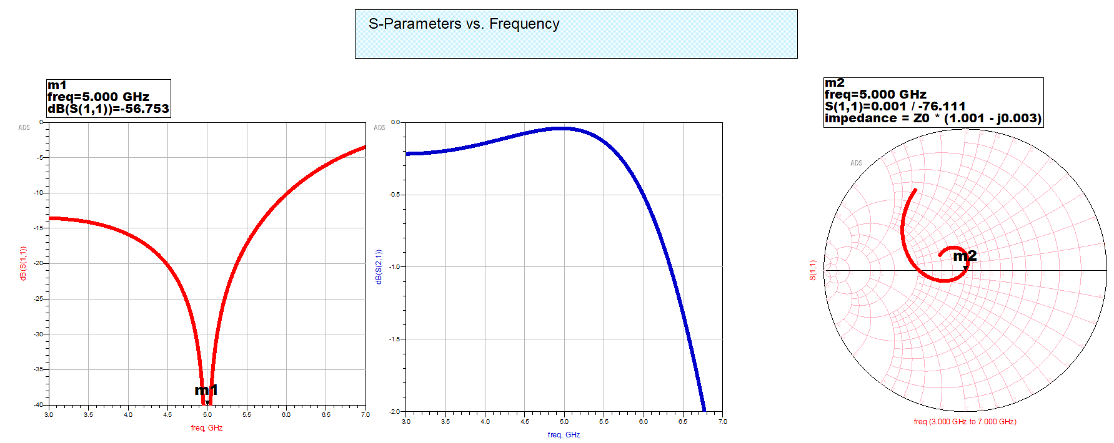
MStrip_V3

Slide 12
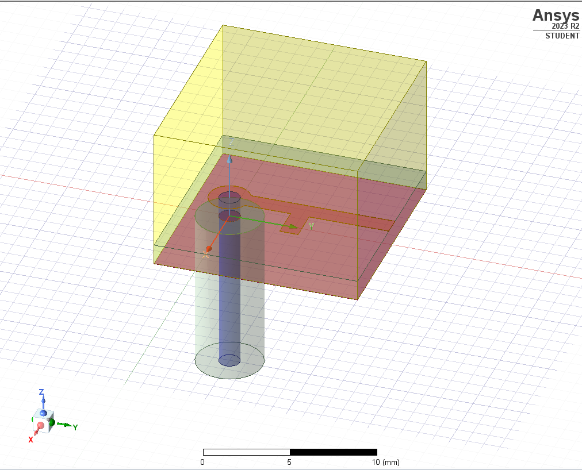
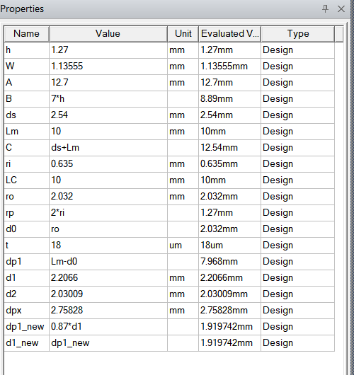
HFSS V3

Slide 13
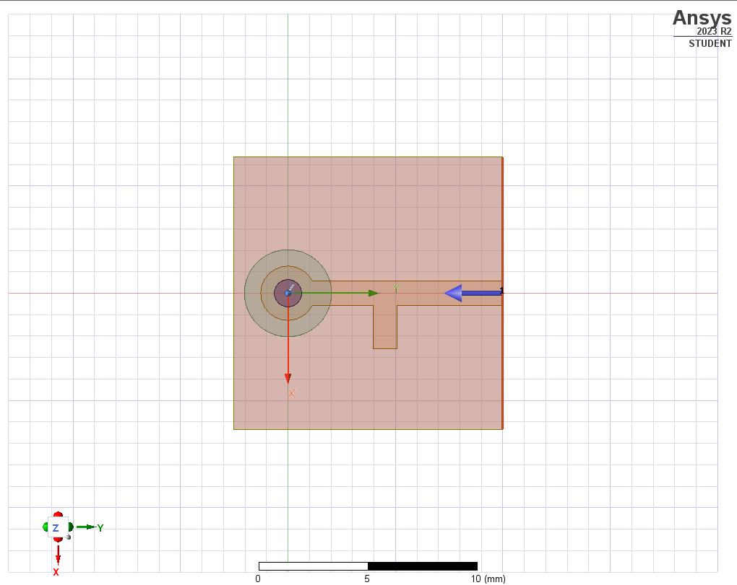
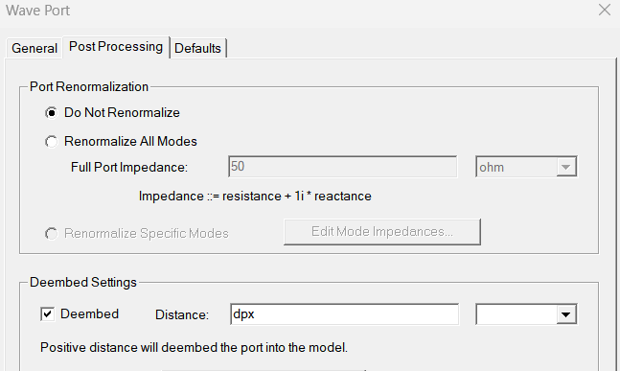
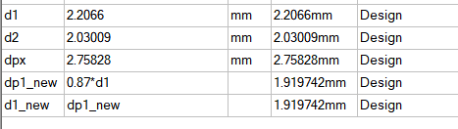

Slide 14
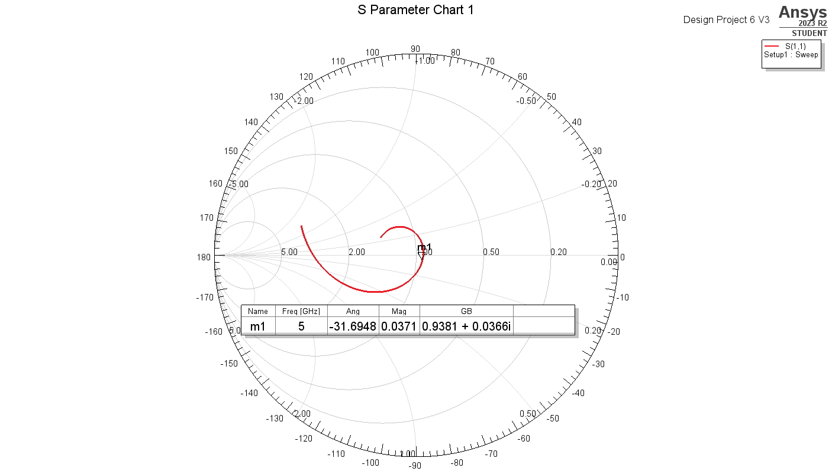

Slide 15
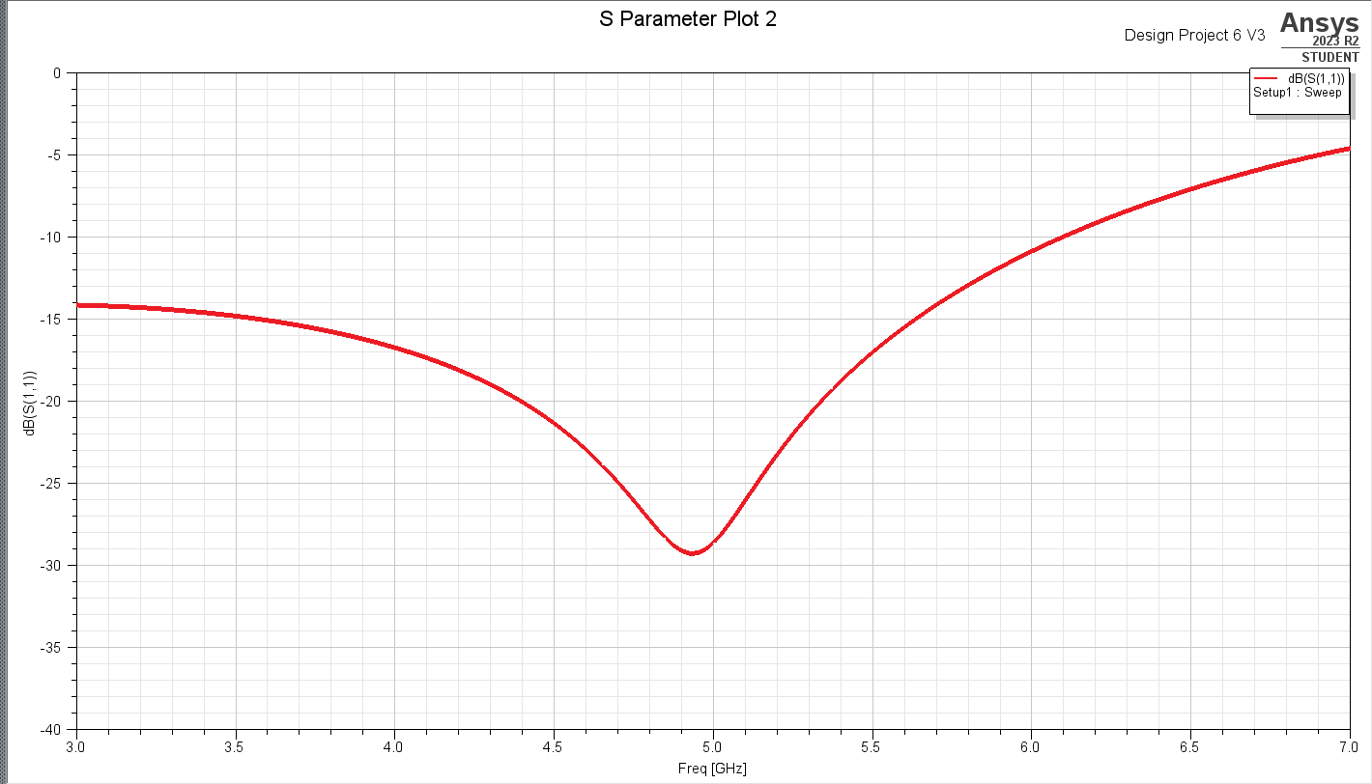

Slide 16
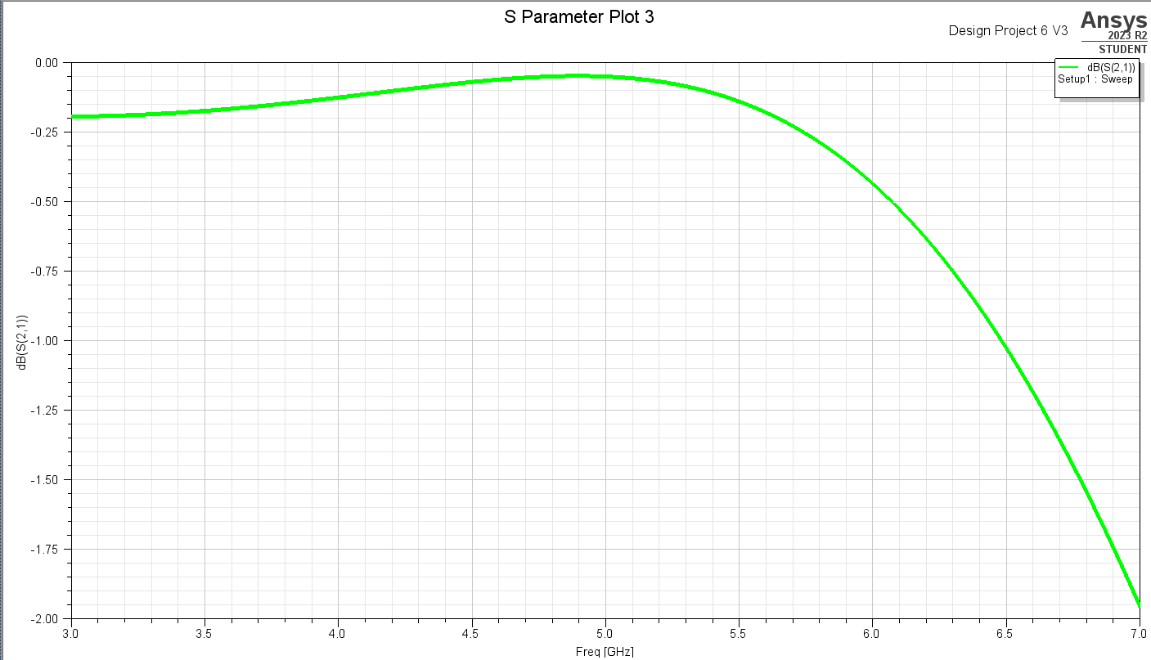

Slide 17
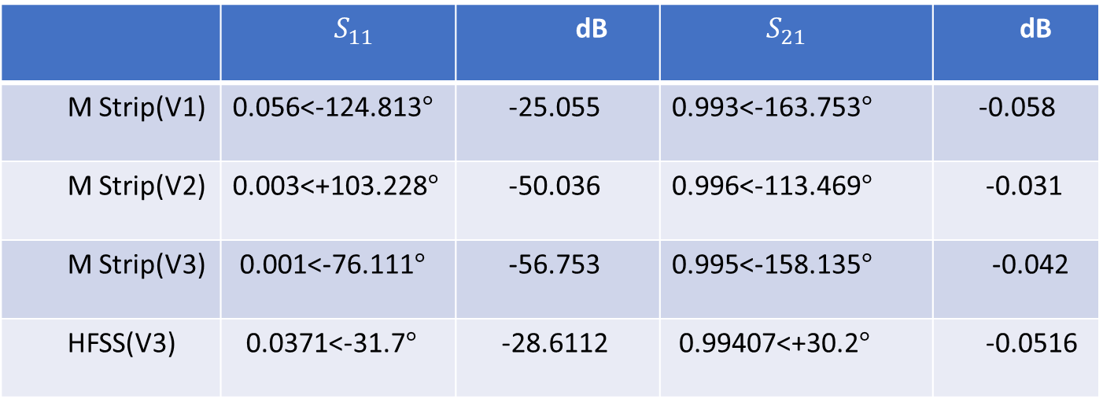
 | $S_{11}$ | dB | $S_{21}$ | dB
M Strip(V1) | 0.056<-124.813$°$ | -25.055 | 0.993<-163.753$°$ | -0.058
M Strip(V2) | 0.003<+103.228$°$ | -50.036 | 0.996<-113.469$°$ | -0.031
M Strip(V3) | 0.001<-76.111$°$ | -56.753 | 0.995<-158.135$°$ | -0.042
HFSS(V3) | 0.0371<-31.7$°$ | -28.6112 | 0.99407<+30.2$°$ | -0.0516

Slide 18
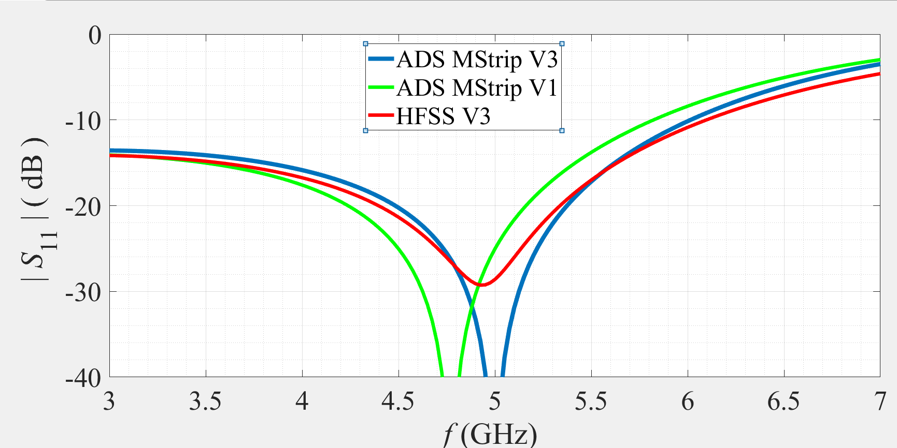

Slide 19

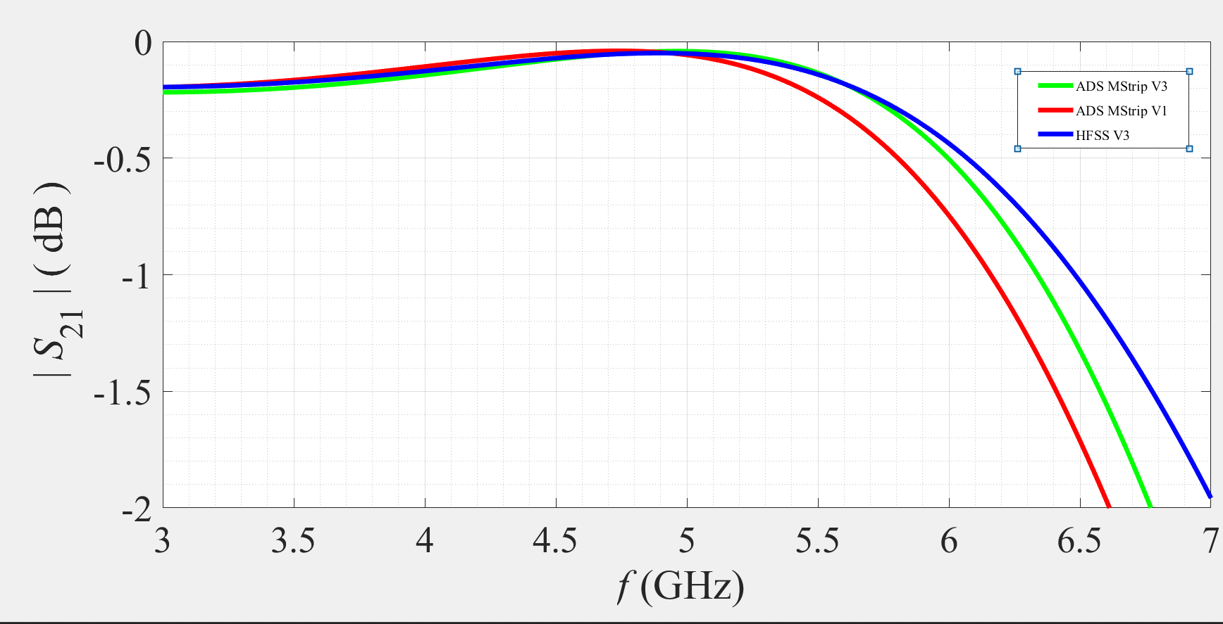

Slide 20
Appendices
MATLAB
HFSS
- ADS

Slide 21
THE END

